Slide 1
Chapter 1: Precalculus Review and Proof by induction
NoBS Calculus (Jeffrey WanG)
Presented by: Maria Henriquez

Slide 2
Section 1
Functions

Slide 3
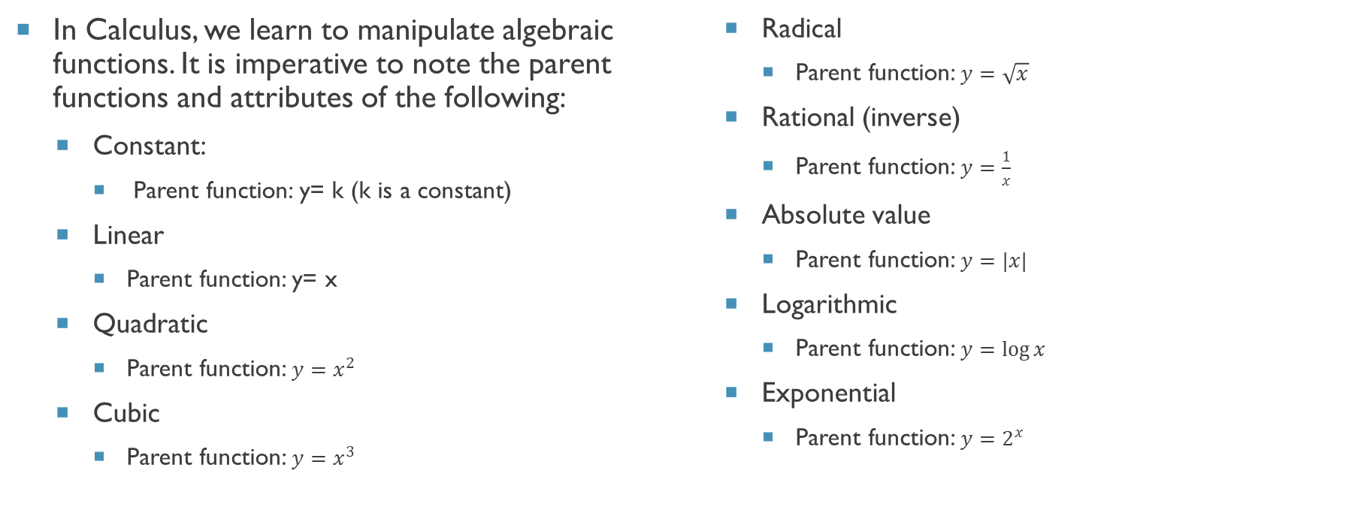
Function Parent Values
In Calculus, we learn to manipulate algebraic functions. It is imperative to note the parent functions and attributes of the following:
  Constant:
    Parent function: y= k (k is a constant)
  Linear
    Parent function: y= x
  Quadratic
    Parent function: $y=x^{2}$
  Cubic
    Parent function: $y=x^{3}$
  Radical
    Parent function: $y=\sqrt{x}$
  Rational (inverse)
    Parent function: $y=\frac{1}{x}$
  Absolute value
    Parent function: $y=|x|$
  Logarithmic
    Parent function: $y=\log{x}$
  Exponential
    Parent function: $y=2^{x}$

Slide 4
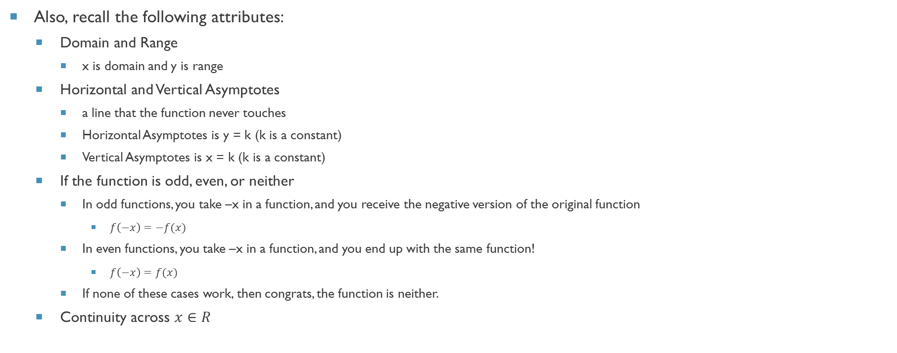
Function Attributes
Also, recall the following attributes:
  Domain and Range
    x is domain and y is range
  Horizontal and Vertical Asymptotes
    a line that the function never touches
    Horizontal Asymptotes is y = k (k is a constant)
    Vertical Asymptotes is x = k (k is a constant)
  If the function is odd, even, or neither
    In odd functions, you take –x in a function, and you receive the negative version of the original function
      $f\left(−x\right)=−f(x)$
    In even functions, you take –x in a function, and you end up with the same function!
      $f\left(−x\right)=f(x)$
    If none of these cases work, then congrats, the function is neither.
  Continuity across $x∈R$

Slide 5
Section 2
trigonometry

Slide 6
Important concepts in Trigonometry
The following is a list of the most important concepts in Trigonometry in calculus:
  Trigonometric functions
    Especially Graphs and their behaviors!
  The unit circle
    Think of this as a graph with four quadrants
  Trigonometric identities

Slide 7
Section 3
Proof by induction
With contributions by Garrett Gu

Slide 8
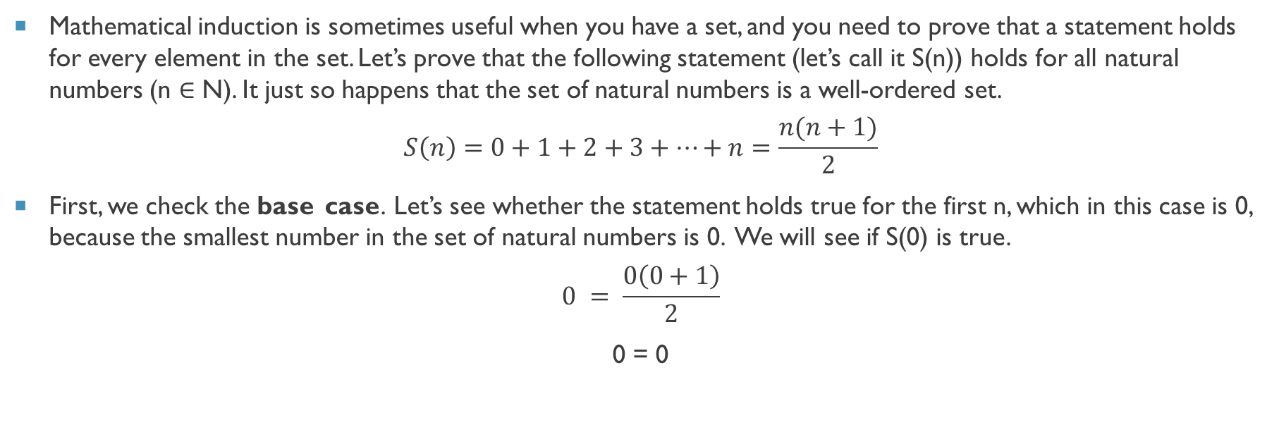
Proof by induction
Mathematical induction is sometimes useful when you have a set, and you need to prove that a statement holds for every element in the set. Let’s prove that the following statement (let’s call it S(n)) holds for all natural numbers (n $∈$ N). It just so happens that the set of natural numbers is a well-ordered set.
$$S\left(n\right)=0+1+2+3+…+n=\frac{n(n+1)}{2}$$
First, we check the base case. Let’s see whether the statement holds true for the first n, which in this case is 0, because the smallest number in the set of natural numbers is 0. We will see if S(0) is true.
$$0 = \frac{0\left(0+1\right)}{2}$$
0 = 0

Slide 9
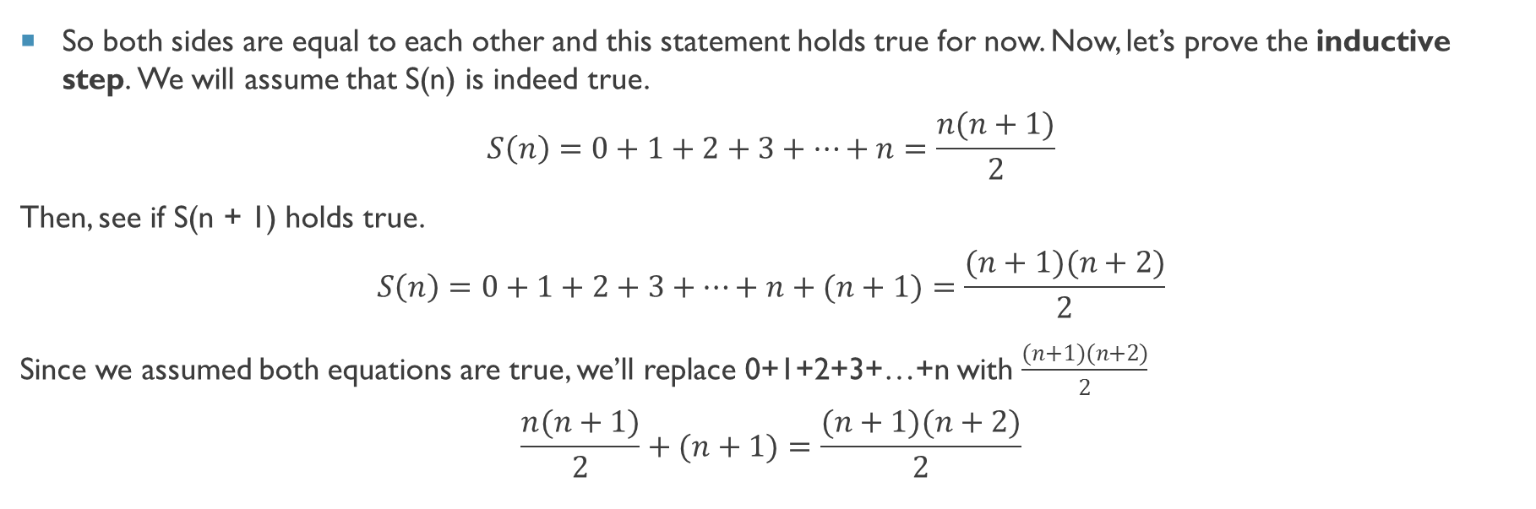
Proof by induction
So both sides are equal to each other and this statement holds true for now. Now, let’s prove the inductive step. We will assume that S(n) is indeed true.
$$S\left(n\right)=0+1+2+3+…+n=\frac{n(n+1)}{2}$$
Then, see if S(n + 1) holds true.
$$S\left(n\right)=0+1+2+3+…+n+(n+1)=\frac{(n+1)(n+2)}{2}$$
Since we assumed both equations are true, we’ll replace 0+1+2+3+…+n with $\frac{(n+1)(n+2)}{2}$
$$\frac{n(n+1)}{2}+(n+1)=\frac{(n+1)(n+2)}{2}$$

Slide 10
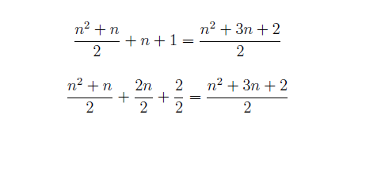

We have shown that if S(n) is true, S(n + 1) is also true. Since we have shown that S(0) is
true, we can plug n = 0 into what we just proved to show that S(1) is also true. We can then use
that to show that S(2) is also true, and so on.

